Slide 1

THE AGILE MENTALITY
CHAPTER 27
‹#›

Slide 2
Topics
Why Use Agile and Scrum?
Agile Development
Manifesto for Agile Software Development
Scrum Methodology
Features of Scrum
The Burndown Chart
‹#›

Slide 3
Why Use Agile and Scrum?
It can be difficult to keep the game development process on track
This is especially true of
Long term projects
Prototypes with lots of iteration
Projects that evolve
Agile and Scrum provide a method of project management that promotes
Personal responsibility
Adaptation to meet evolving needs
Design iteration
Deadline awareness
Feature prioritization and focus
‹#›

Slide 4
Why Use Agile and Scrum?
As a professor, the author found that Agile and Scrum improved
The quality of games created by the students
The level of completeness of the student projects
The sensible scoping of student projects
Student confidence in their development skills
This was the most shocking
The author believes this was tied to the personal responsibility promoted by the Scrum process
This chapter covers two project management strategies that work well together
Agile
Scrum
‹#›

Slide 5
Agile Development
For many years, software projects were first specified and then implemented
This was called the "waterfall method"
Designers would create a Design Document that was handed to engineers to implement exactly
This doesn't work very well for games
Doesn't allow for design iteration
Prevents prototypes from being tested fast enough
It didn't work very well for many kinds of creative software
Developers weren't able to creatively contribute to projects
The lack of iteration led to sub-par software
In 2001, several developers formed the Agile Alliance to address this issue
They collectively created the Manifesto for Agile Software Development
‹#›

Slide 6
The Agile Manifesto
We are uncovering better ways of developing software by doing it and helping others do it.
Through this work we have come to value:
Individuals and interactions over processes and tools
Working software over comprehensive documentation
Customer collaboration over contract negotiation
Responding to change over following a plan
That is, while there is value in the items on the right, we value the items on the left more.
Kent Beck, et al. "Manifesto for Agile Software Development," Agile Alliance (2001)
‹#›

Slide 7
The Agile Manifesto
In game development terms, these four core values become:
Following your individual design sense & continually asking questions over following predefined rules
Making a simple prototype and iterating over waiting until you have the perfect game idea
Bouncing your ideas off of other creative people over worrying about who owns specific intellectual property
Listening to and reacting to playtesters' feedback over following your original design vision
An Agile mentality keeps your game evolving as you develop it
But it's also important to keep the project on schedule
‹#›

Slide 8
The Scrum Methodology
The Scrum Methodology works very well to keep Agile projects on time and on budget
The goal of Scrum is to get to a playable game as quickly as possible while allowing design flexibility
Features of Scrum
The Scrum Team
Feature List
Releases and Sprints
The Scrum Meeting
The Burndown Chart
‹#›

Slide 9
Features of Scrum
The Scrum Team
Product Owner
The voice of the client / players
Wants all the coolest features to make it into the game
Responsible for understanding the gestalt vision of the game
Scrum Master
The voice of reason
Wants to make sure everyone is on-task without being overworked
Responsible for keeping the project on schedule and cutting if necessary
Runs the daily Scrum Meeting
Development Team
Everyone who is actively working on the project
Assigned daily tasks at the Scrum Meeting
Often also includes the Product Owner and Scrum Master
The Product Owner and Scrum Master are natural foils
‹#›

Slide 10
Features of Scrum
Backlog / Feature List
A list of all the features that the team/client wants in the game
Some start vague but increase in specificity
Eventually broken down into tasks
No individual task should be estimated to take longer than 8h (hours)
Releases and Sprints
Product cycle is broken into Releases and Sprints
A Release is a known time when the game will be shown to people outside the team (e.g., client, investors, playtesters)
A Sprint is a version of the game along the way to a release
Usually a Sprint lasts 1-4 weeks
The game must be playable and bug-free at the end of each sprint
In the best case, the game should be playable at the end of each day
Each Sprint has its own Sprint Backlog of features that will be complete by the end of the Sprint
‹#›

Slide 11
Features of Scrum
The Scrum Meeting
A Scrum Meeting occurs every morning during a Sprint
It is a 15-minute stand-up meeting to keep everyone on track
Literally everyone stands through the entire meeting to keep it short
The meeting is run by the Scrum Master
She asks each person on the team 3 questions:
What did you accomplish since yesterday?
What do you plan to accomplish today?
What obstacles might get in your way?
This ensures that everyone on the team is aware of overall progress
Also enforces personal responsibility for tasks
Any questions that come up are recorded and tabled for discussion after the meeting
All progress is tracked on a shared Burndown Chart
‹#›

Slide 12
Features of Scrum
The Burndown Chart
Tracks team progress towards a Sprint deadline
Compares total estimated time for tasks against daily progress (the Burndown Rate)
Uses this information to predict whether or not the team will complete the project on time
‹#›

Slide 13
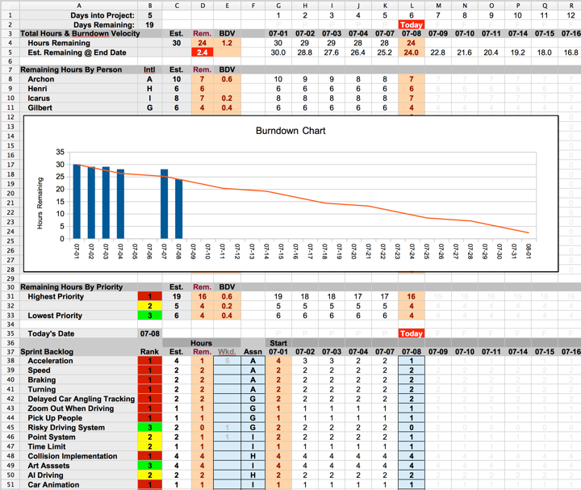
Anatomy of a Burndown Chart
‹#›

Slide 14
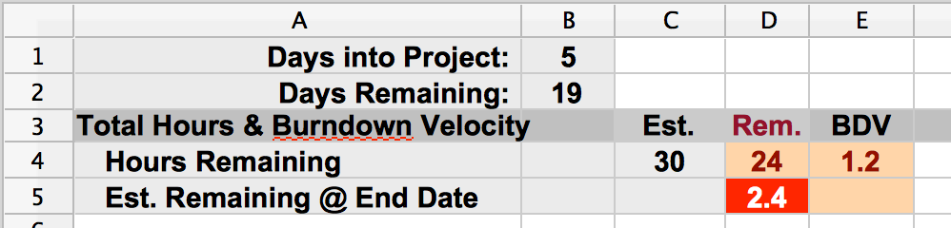
Anatomy of a Burndown Chart
‹#›

Slide 15
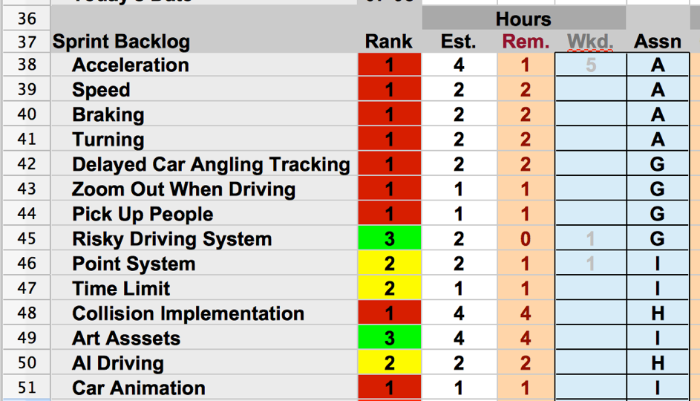
Anatomy of a Burndown Chart
‹#›

Slide 16
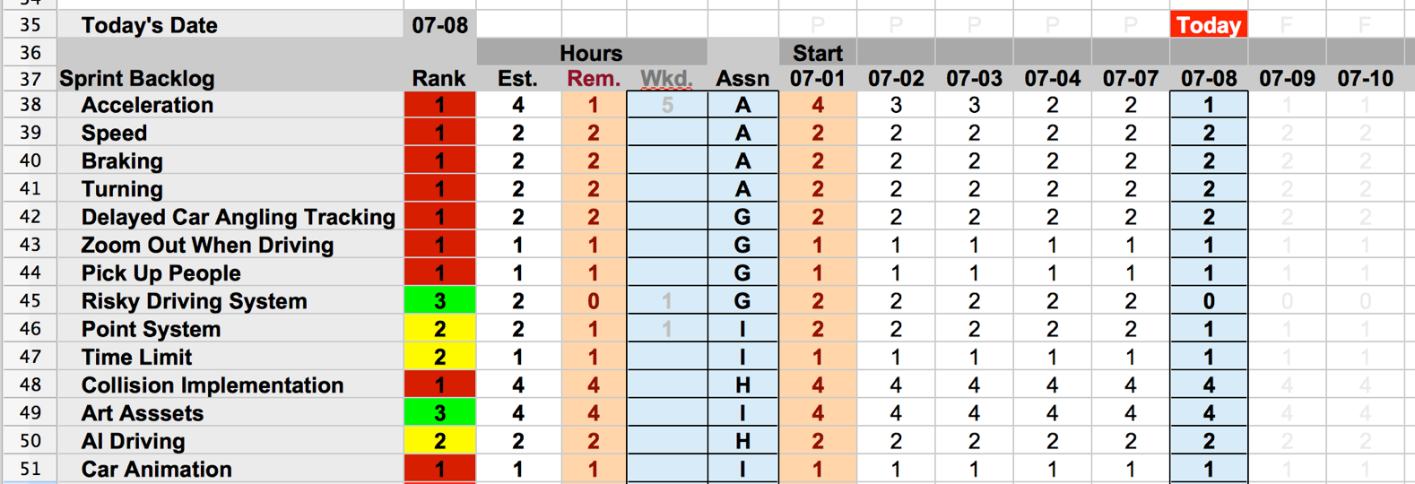
Anatomy of a Burndown Chart
‹#›

Slide 17
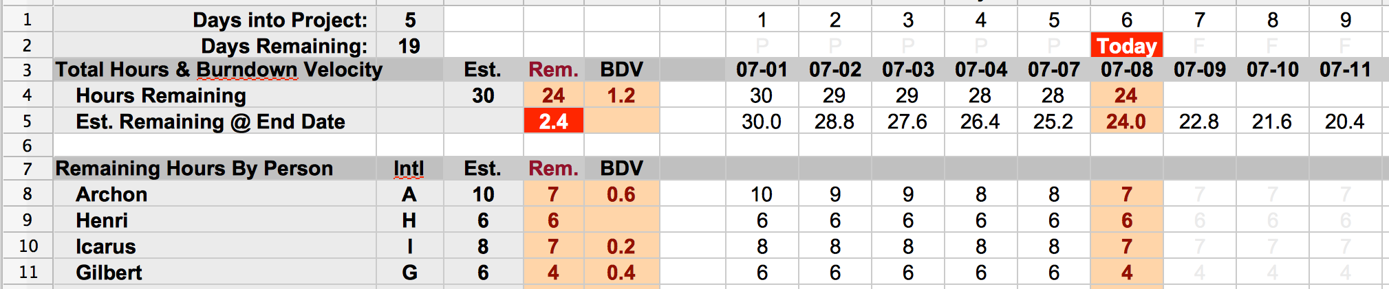
Anatomy of a Burndown Chart
‹#›

Slide 18
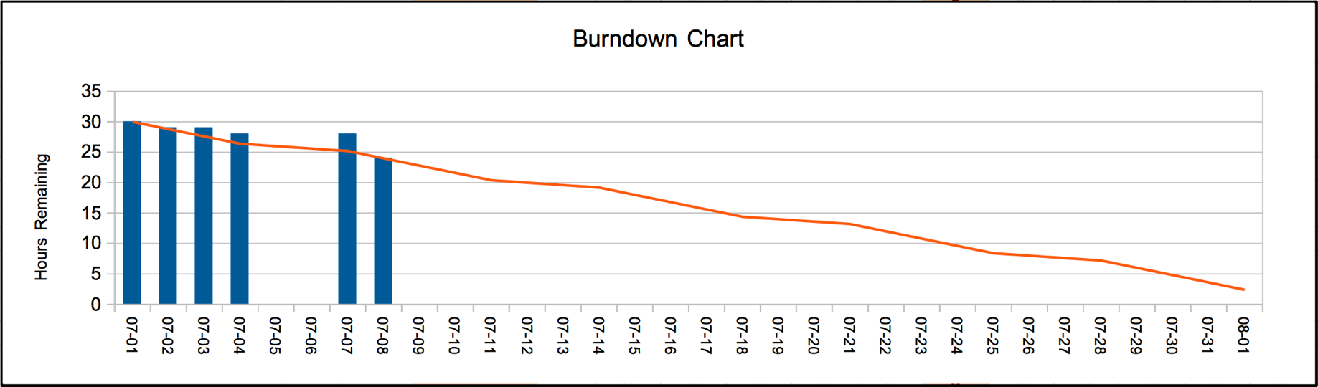
Anatomy of a Burndown Chart
‹#›

Slide 19
ESTIMATED HOURS
Team estimates hours to complete each task
Uses their best guess
When burning down a task, mark down hours based on percent of task that remains
Not actual hours worked!!!
Example: You estimate a task will take 4h to complete
You work 6h on the task, but it's 50% complete
Mark 2h remaining on the Burndown Chart
Alternatively, you work 1h on the task, but it's 75% complete
Mark 1h remaining on the Burndown Chart
Always think in terms of original estimated hours
‹#›

Slide 20
The Burndown Chart
Most useful on 1-4 week Sprints
Also most useful for teams that do about the same amount of work each day
If the team changes their rate of work drastically, the Burndown Chart will not adjust to reflect this
‹#›

Slide 21
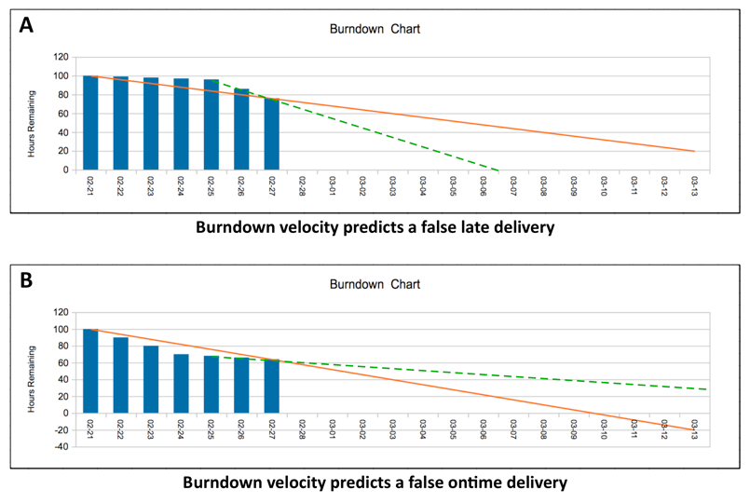
The Burndown Chart
‹#›

Slide 22
The Burndown Chart
Most useful on 1-4 week Sprints
Also most useful for teams that do about the same amount of work each day
If the team changes their rate of work drastically, the Burndown Chart will not adjust to reflect this
This is only an issue for teams that make drastic changes to their work per day
‹#›

Slide 23
Chapter 27 – Summary
The Agile mentality and Scrum are fantastic tools for developers of games and game prototypes
At large companies, they are generally used in the Preproduction phase of game development
Switch to a more "waterfall" approach for Production phase once the core gameplay and design have been discovered through Agile and Scrum
The Burndown Chart is the best tool the author has found for tracking small, agile projects
Next: Part III – Game Prototype Examples and Tutorials
Eight different game tutorials for everything from a Space Shooter to Card Games to a Word Game
Followed by an Appendix of Useful Concepts for game dev
‹#›

